Slide 1
Chile's Tourism Regions
MSCA 31015 Data Science for Consulting
Jianghong Man

Slide 2
Improve the Tourism Industry in Chile
Objective: Suggestions and recommendations for Chilean government to improve the tourism industry in the country
Approach: Develop PCA analysis, which is a data reduction technique to find variables capturing the most possible variance, and calculate the weighted average for each variable in principal components to generate a overall score for each dimension. Thus, by ranking the scores of each region in a total 10 dimension, we can see the strength and weakness of each region in Chile.
Result:
The model developed will deliver a clear view of the current situation among 10 dimensions in different regions of Chile based on the data and information provided up to date.
The model can be updated and improved as new data and information is available.

Slide 3
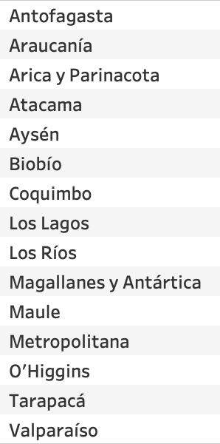
Data
Region list:
Dimension list:
1: cultural heritage and events
2: natural resources and sustainability
3: human resources and tourism-related workforce development
4: tourism infrastructure
5: tourism mobility and transportation infrastructure
6: tourism-related services
7: security and safety
8: economic performance
9: tourism promotion
10: governmental involvement and efficiency

Slide 4


PCA Analysis

Slide 5
PCA Result

Slide 6
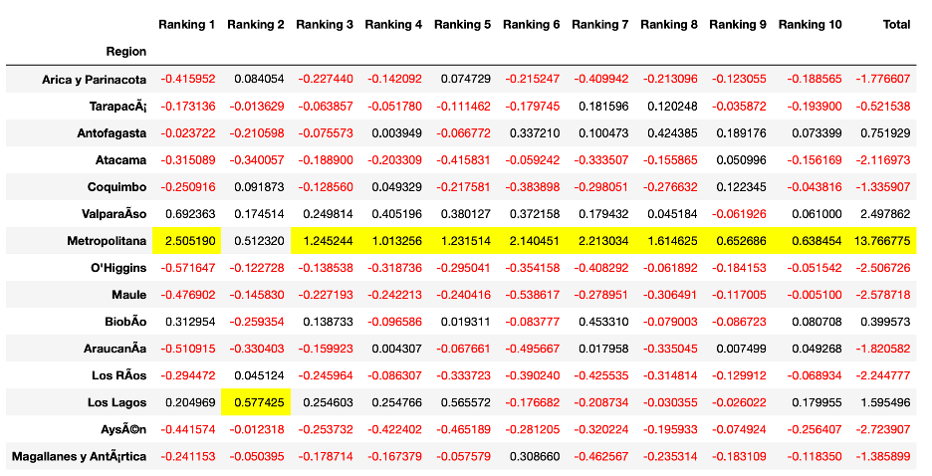
Score for Each Region from Dimension 1-10

Slide 7
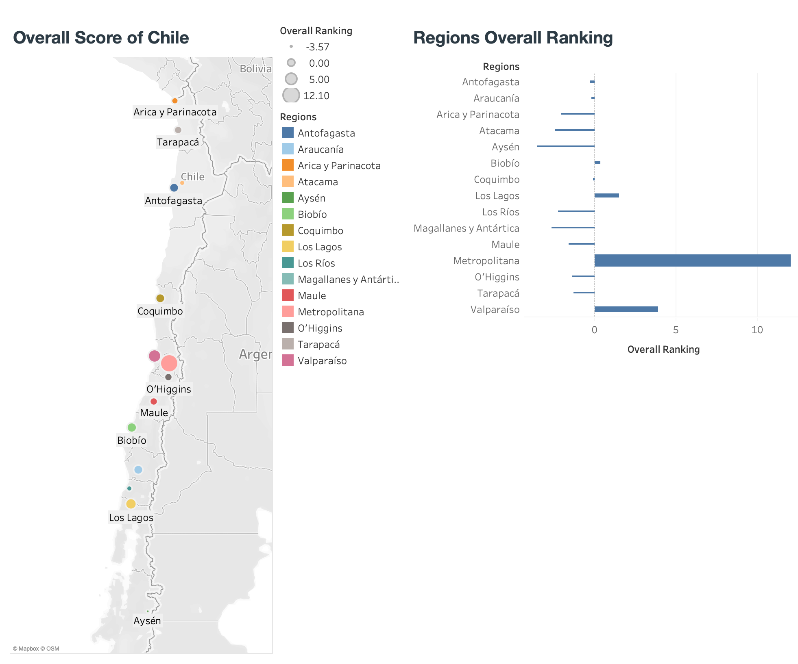
Overall Score Visualization

Slide 8
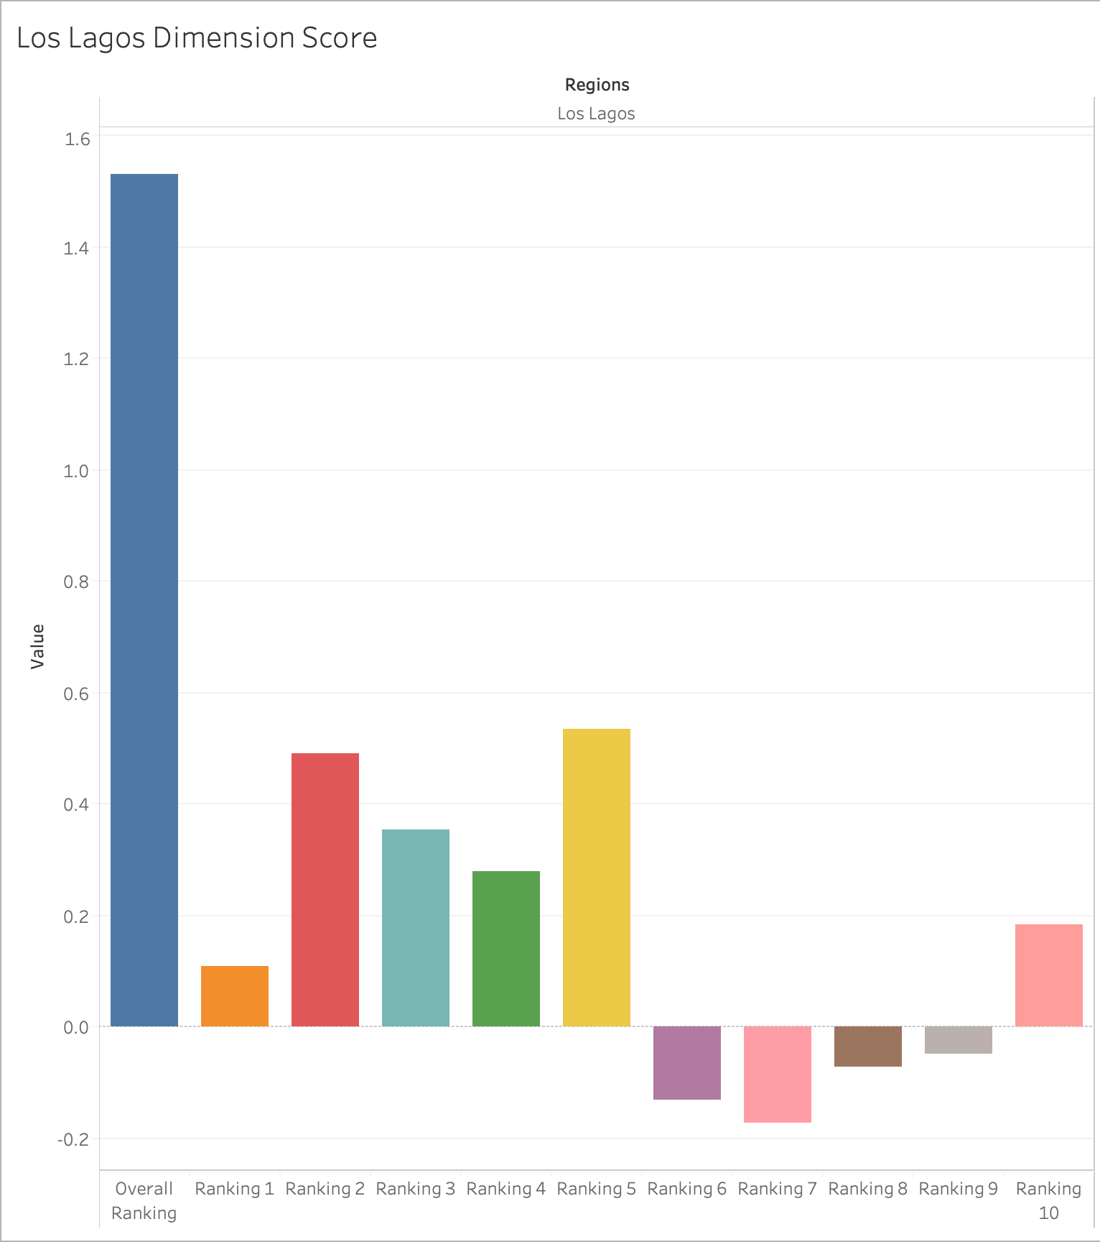
Region 1: Los Lagos
Los Lagos Region contains the country's second largest island, Chiloé, and the second largest lake, Llanquihue in Chile. There are many natural sites such as islands and peninsulas. Travelling by ferries and cruises is a better choice for most tourists. Also, hot springs and recreational fishing are popular offers. According to the analysis, the proportion oriented towards tourism is the highest among all the regions. Also, the tourism infrastructure is mature in this region. For instance, the number of establishments with a tourist-related certification is significantly high. Thus, Los Lagos is a perfect tourist attraction with a good integration of nature and humanities. However, from the second analysis, we can see that the score of tourism-related service, security, and tourism promotion are quite low. Thus, the government should pay more attention to let tourists better know this beautiful region.

Slide 9
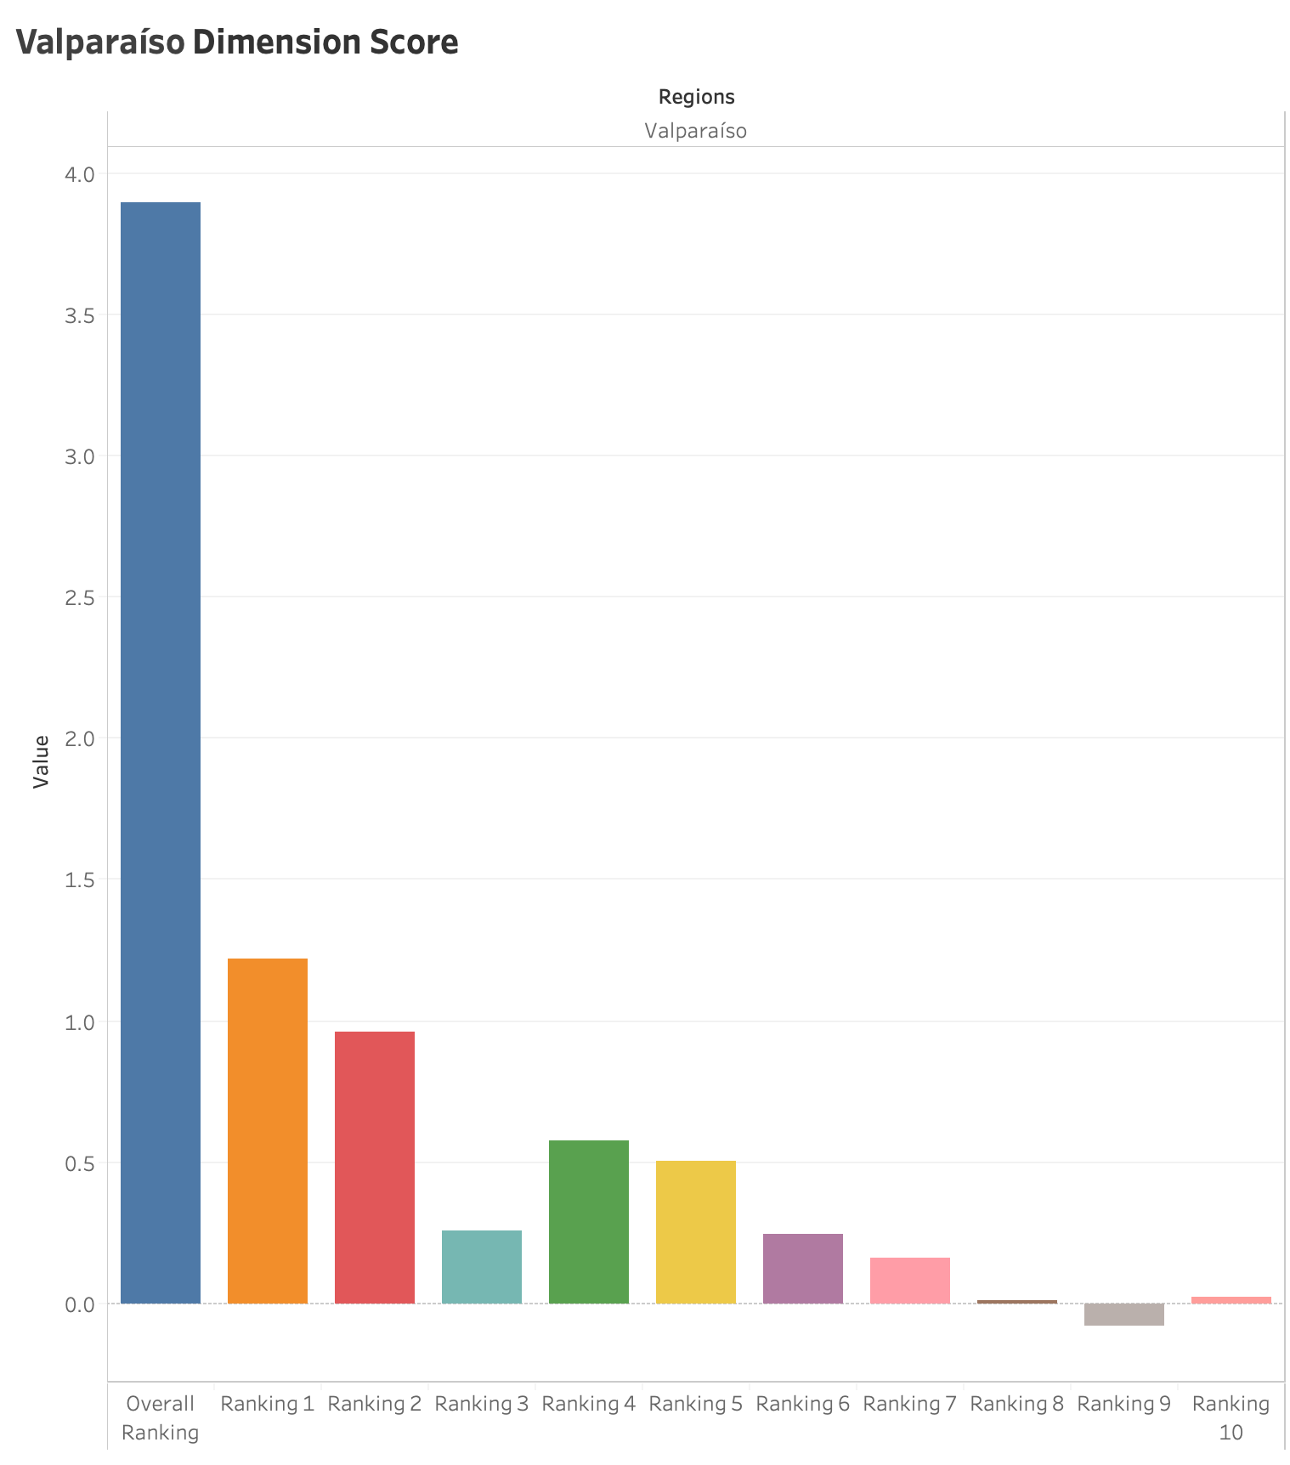
Region 2: Valparaíso
As the second-largest metropolitan area in the country, Valparaíso is a seaport, naval base and educational center in Chile. Today, many thousands of tourists visit Valparaíso from around the world to enjoy the city's labyrinth of cobbled alleys and colorful buildings. Valparaíso also receives growing attention from cruise ships that visit during the South American summer. It has the most amount of beaches. The main positive economic impacts of coastal tourism are contributions to government revenues, foreign exchange earnings, generation of employment, and business opportunities. However, massive influxes of tourists, often to a relatively small area, have a negative impact on the local environment. They add to the pollution, waste, and water needs of the local population, putting local infrastructure and habitats under enormous pressure. Especially reflected by the analysis, the number of environmental complaints is high in this region and the government should put more money to solve the environmental issues. Also, Valparaíso has the second high score besides Metropolitana in the 6-10 dimension analysis. However, tourism promotion of this area is not enough. Thus, government should pay more attention and grant more funds on this area.

Slide 10
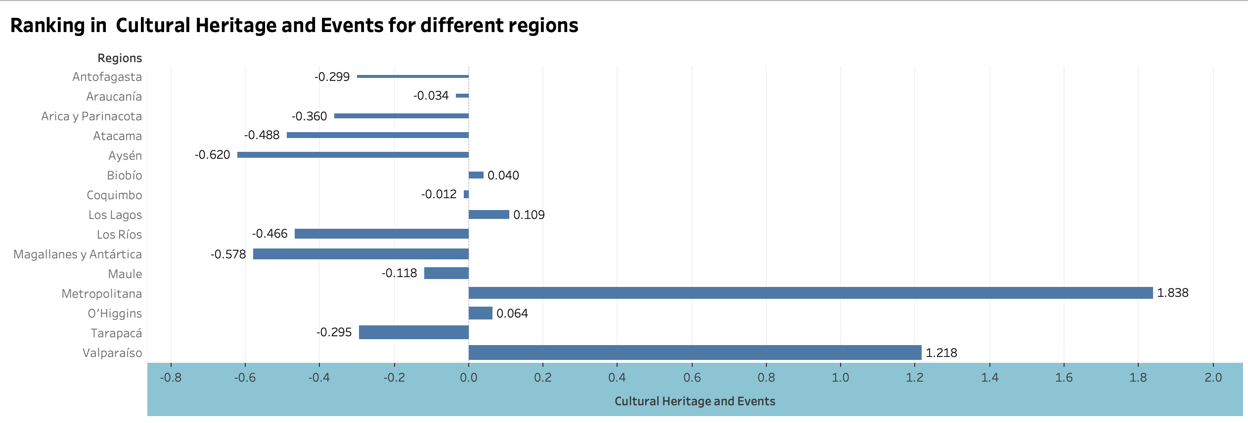
Dimension 1: Cultural Heritage and Events
There are so many famous and unique cultural sites in Chile, especially to the tourists who do not come from western south America. And Chile does well to promote its culture by having events and showing historical and cultural heritage. Apart from completing its infrastructure, the government of Chile can also explore the area such as digital ticketing, online exhibition, and live streaming event. Also, the retail stores and commercial streets around those cultural sites can bring revenue to the overall tourism industry.

Slide 11
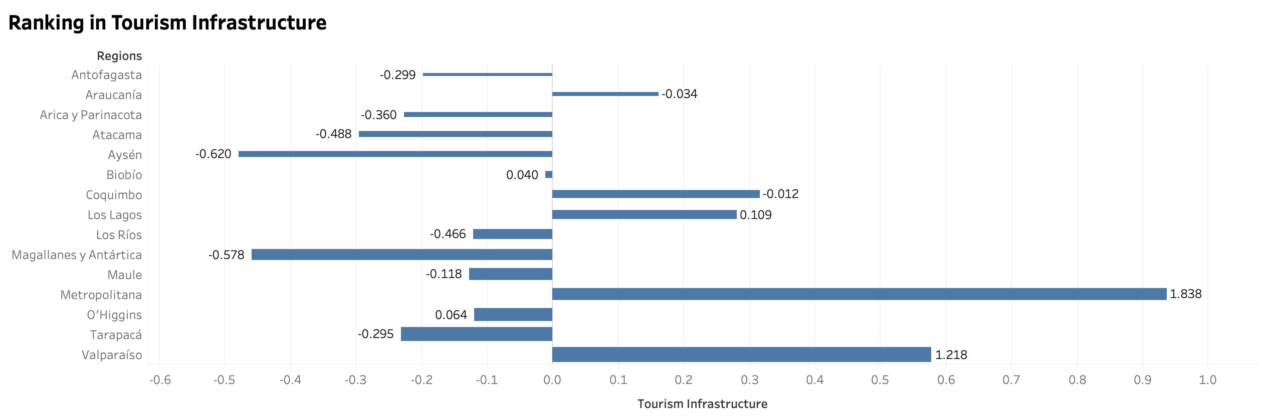
Dimension 2: Tourism Infrastructure
Hotel services, digital ticketing services and room services are extremely important to provide tourists a comfortable rest in the middle of the trip. Especially, with a veritable banquet of options at their fingertips, travelers are demanding more than ever before. The collection and use of customer data will allow a hotel to effectively personalize their service for guests. And this "personalized" service can also be realized by the digital transformation. Thus, the government should consider investing in this area specifically such as global hotels and Airbnb etc. In this way, the tourists will slow their steps and enjoy their whole trip.

Slide 12
Thank you!

